Slide 1
Consumption of fruit and vegetables in Europe 2024
Conducted by Kantar for Stiftelsen Opplysningskontoret for frukt og grønt (OFG)
Omar Harby

Slide 2
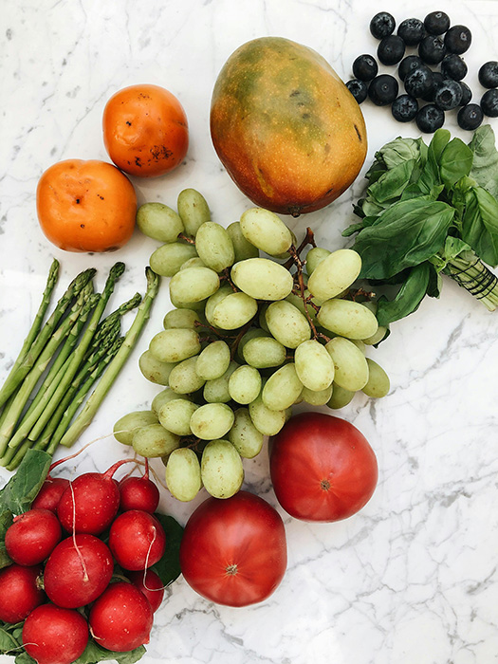
ABOUT THE SURVEY
The foundation Opplysningskontoret for frukt og grønt (OFG) has since 2017 conducted a yearly study to measure the consumption of fruit, berries and vegetables in various European countries. This survey has been repeated in 2024.
Several questions have been included in the Norwegian survey, i.a. related to children's consumption, consumption of fruit and vegetables and some questions about price, since food prices are now rising.
This report includes the main results from the European countries, where less questions were asked than in the Norwegian survey. A separate report deals with the questions about the use of fruit and vegetables in Norway.
The results are weighted by gender, age and education.
METHODOLOGY
SAMPLE
FIELD PERIOD
Web survey
National representative
sample in each country
18+ years old
9034 interviews
05.09.24 – 20.09.24

Slide 3
ONE PORTION
Fruit and berries
One portion of fruit and berries is more or less a handful. It can be a medium-sized fruit such as an apple, banana or pear, or a piece of a large-sized fruit as melon, pineapple or mango. It could also be a handful of small-sized fruits like grapes, plums, kiwi or a handful of berries. We are thinking of fruit/berries in all formats: fresh, frozen, canned, in homemade smoothies etc.
Vegetables and salad
One portion is more or less a handful vegetables and salads. One portion could include a big tomato, seven cherry tomatoes, a carrot, a handful of broccoli or a small bowl of salad. Please consider vegetables and salads of all formats: fresh, frozen, canned, fried, in homemade smoothies etc.
Juice (not nectar)
A glass of juice is about 2 dl. Please think about pure fruit- and/or vegetable juice, not nectar or other not pure juice products. One portion is defined as 1 dl or half a glass of juice.
Smoothie (bought, not homemade)
A glass of smoothie is about 2 dl. Think of any type of smoothie you can buy made from fruit and/or vegetables. One portion is defined as 1 dl or half a glass of smoothie.

Slide 4
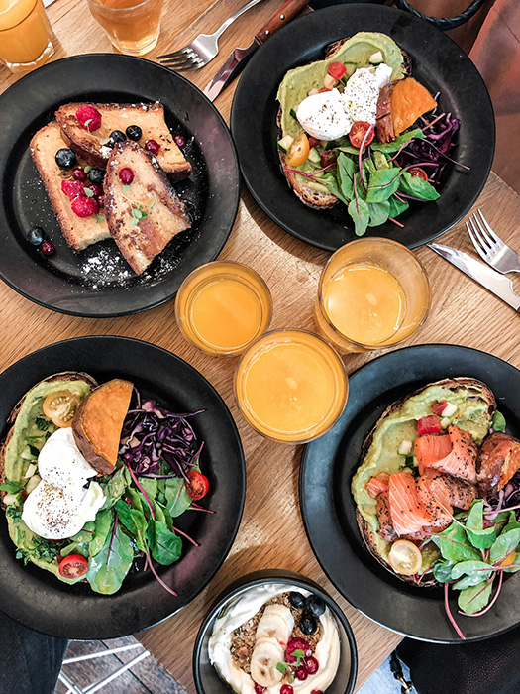
CONSUMPTION
Consumption of fruit/berries and vegetables in day-to-day life

Slide 5
Portions of fruit and berries daily
How many portions of fruit and berries do you usually eat?
UK CITIZENS STILL EAT MORE FRUIT AND BERRIES DAILY COMPARED TO OTHER EUROPEAN COUNTRIES
Eating at least one portion of fruit and berries each day, is most common in Spain and Italy. 73% report eating at least one portion of fruit and berries each day in Spain, and 68% report the same in Italy.
Only half of the sample in Sweden say they eat a portion of fruit and berries at least once a day.

Slide 6
Portions of vegetables or salad (ex. potatoes) daily
How many portions of vegetables or salad (ex. potatos) do you usually eat?
THE UK IS ALSO AT THE TOP WHEN IT COMES TO EATING VEGETABLES DAILY
23% of the UK sample say they eat at least three portions of vegetables each day.
Italy has the highest share of respondents who eat at least one portion of vegetables each day (72%) – but has fewer respondents who eat at least three portions of vegetables daily.

Slide 7
Glasses of juice (not nectar) daily
How many glasses of juice (not nectar) do you usually drink?
THE NORDIC COUNTRIES DRINK SIGNIFICANTLY LESS JUICE THAN THE REST OF EUROPE.
50% of France drink at least one glass of juice each day, compared to 13% in Denmark.

Slide 8
Glasses of smoothie daily
How many glasses of smoothie (bought in a store – not homemade) do you usually drink?
THE NORDIC COUNTRIES ALSO DRINK SIGNIFICANTLY LESS SMOOTHIE DAILY THAN THE REST OF EUROPE
7% of the sample drink at least three portions of smoothie each day in Spain and Germany.

Slide 9
Total consumption of fruits and vegetables daily
THE TOTAL CONSUMPTION OF FRUIT AND VEGETABLES VARIES BETWEEN THE EUROPEAN COUNTRIES
37% of UK citizens eat at least five portions of fruit and vegetables each day.
Scandinavians eat less fruit and vegetables daily compared to other Europeans. The only exception is Norway, where 1/4 of the population eat at least five portions of fruit and vegetables each day.

Slide 10
Daily consumption
The percentage who eats at least 5 portions of fruit/berries or vegetables every day
Mean – daily consumption of fruit/berries and vegetables
Calculation: Consumption of juice and smoothie counts for maximum one portion a day. Those who answer: «I don’t know», and those who haven’t given an answer to how many fruits/berries/vegetables/drinks they eat/drink are excluded from the calculation.

Slide 11
The percentage who eats at least 5 portions of fruit/berries or vegetables every day – development over time
Calculation: Consumption of juice and smoothie counts for maximum one portion a day. Those who answer: «I don’t know», and those who haven’t given an answer to how many fruits/berries/vegetables/drinks they eat/drink are excluded from the calculation.

Slide 12
Mean – daily consumption of fruit/berries and vegetables – Development over time
Calculation: Consumption of juice and smoothie counts for maximum one portion a day. Those who answer: «I don’t know», and those who haven’t given an answer to how many fruits/berries/vegetables/drinks they eat/drink are excluded from the calculation.

Slide 13
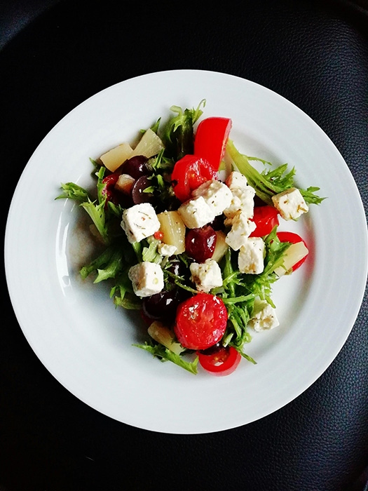
SUMMARY

Slide 14
SUMMARY
Eating at least five portions of fruit and vegetables each day is most common in the UK – but the share has decreased significantly since 2020.
The Nordic countries drinks less juice and smoothie than the rest of Europe.
There’s an increase in the share who eat at least five portions of fruit and vegetables every day across most of Europe – the only exception being the UK, Denmark and the Netherlands. The biggest increase from 2022 happened in Norway (+6 pp), Germany (+5 pp) and Spain (+4 pp).
The mean consumption of fruit and vegetables is, on the other hand, more stable across Europe, with few changes from last year.

